Slide 1

Company Bankruptcy Prediction
Team Runtime Terror
Sayan Saha
Mayuresh Agashe
Hemanth Sai Garladinne

Slide 2
A slow yet efficient approach to tune the best hyperparameters for our model by exploring all combinations
(Inferential + Descriptive Statistics)
Metrics of all models are stored in a dictionary
Exploratory Data Analysis
Feature Selection
Grid Search CV
Model Training
Log Metrics
Extracting the columns with important features
Fitting an estimator to be able to predict the classes to which unseen samples belong.

Slide 3
Challenges deep-dive
Challenge 1
Challenge 2
Challenge 3
Domain Knowledge
Deciphering the column names and deriving its meaning
Feature Importance
Selecting the top 25 columns with highest correlation amongst them
Dimensionality Reduction
reducing the number of input variables while developing a predictive model.

Slide 4
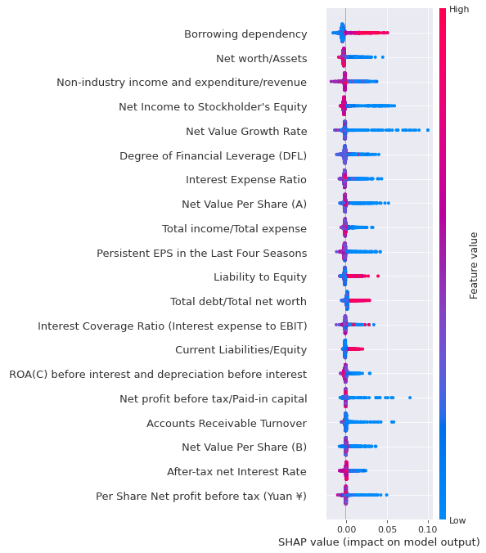
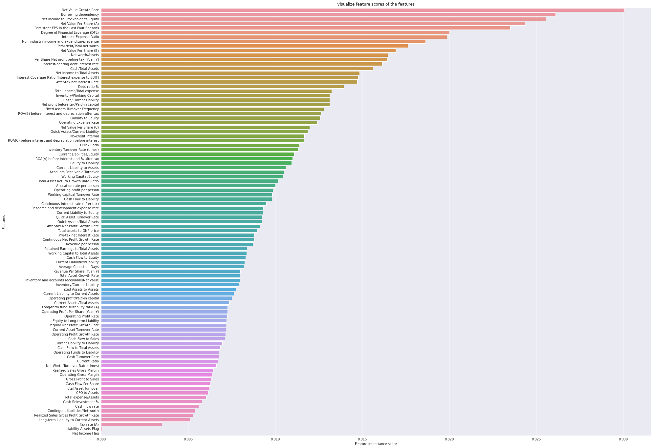
Extracts & Insights

Slide 5
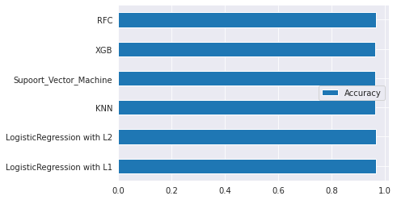
Metrics of Different ML Models
Random Forest
XGBoost
SVM
KNN
Logistic regression L1
Logistics Regression L2
'Logistic Regression with L1': 0.967008797653959,
'Logistic Regression with L2': 0.967008797653959,
'KNN': 0.9640762463343109,
'Supoort_Vector_Machine': 0.9640762463343109,
'XGB': 0.9648093841642229,
'RFC': 0.9655425219941349

Slide 6
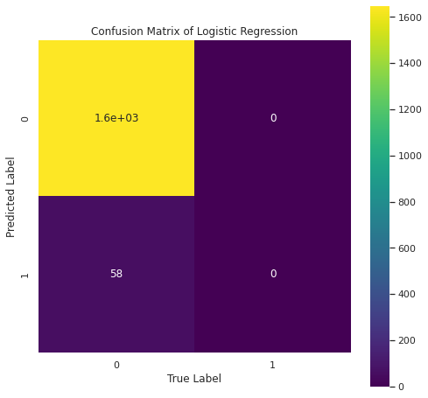
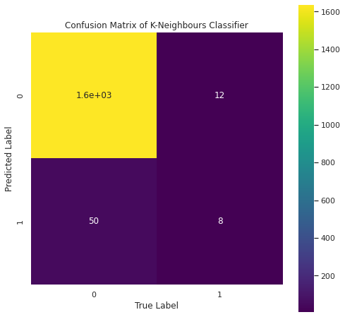
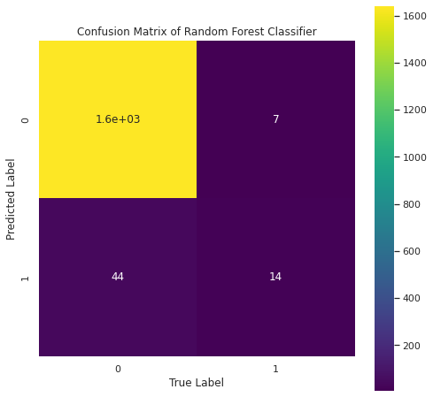
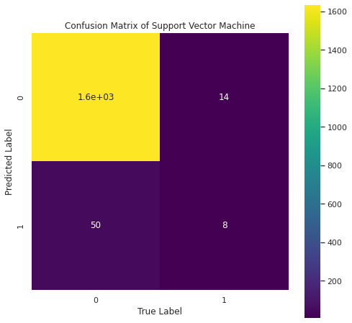
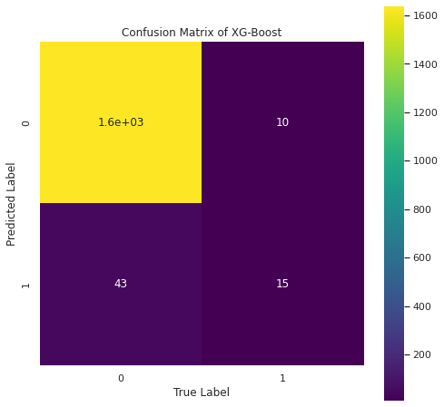

Slide 7

Support Vector Machine
precision recall f1-score support
0 0.97 0.99 0.98 1647
1 0.36 0.14 0.20 58
accuracy 0.96 1705
macro avg 0.67 0.56 0.59 1705
weighted avg 0.95 0.96 0.95 1705
Logistic Regression
precision recall f1-score support
0 0.97 1.00 0.98 1647
1 0.00 0.00 0.00 58
accuracy 0.97 1705
macro avg 0.48 0.50 0.49 1705
weighted avg 0.93 0.97 0.95 1705
XG Boost
precision recall f1-score support
0 0.97 0.99 0.98 1647
1 0.60 0.26 0.36 58
accuracy 0.97 1705
macro avg 0.79 0.63 0.67 1705
weighted avg 0.96 0.97 0.96 1705
Random Forest Classifier
precision recall f1-score support
0 0.97 1.00 0.98 1647
1 0.67 0.24 0.35 58
accuracy 0.97 1705
macro avg 0.82 0.62 0.67 1705
weighted avg 0.96 0.97 0.96 1705
K-Neighbours Classifier
precision recall f1-score support
0 0.97 0.99 0.98 1647
1 0.40 0.14 0.21 58
accuracy 0.96 1705
macro avg 0.69 0.57 0.59 1705
weighted avg 0.95 0.96 0.95 1705
mx growth

Slide 8
Thank You

